Slide 1
Animation
By: Jacob Leboeuf

Slide 2
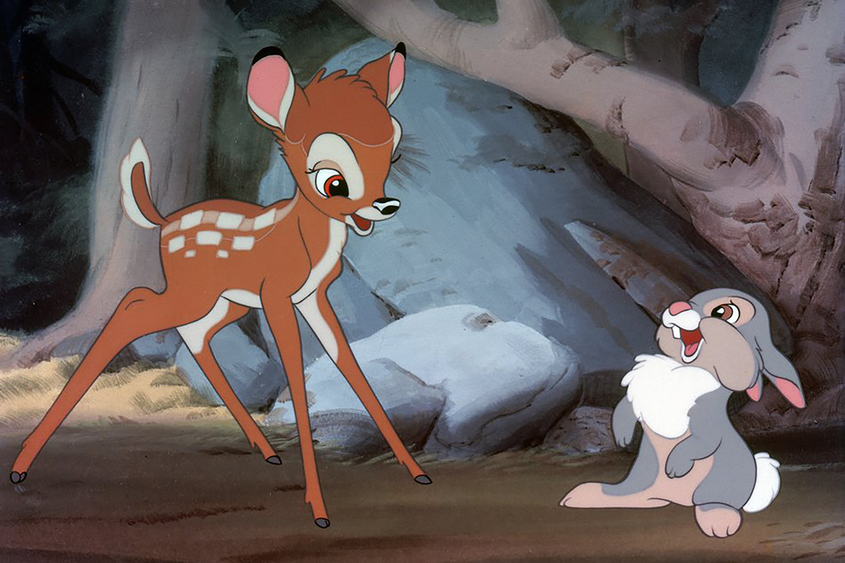
Before Computers
Hand-drawing
Work drawn frame by frame without much assistance from technology
Long and painstaking process
Ex. Bambi (1942), The Jungle Book (1967)
Still used today, but not nearly as popular and never for efficiency reasons

Slide 3
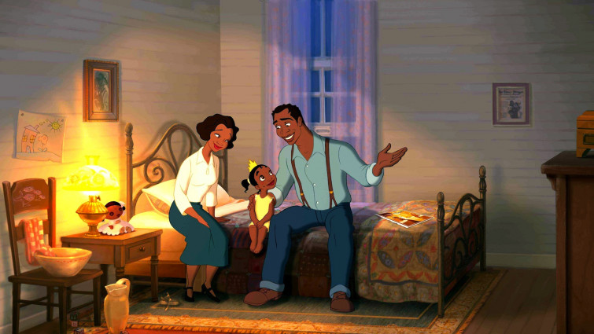

Slide 4
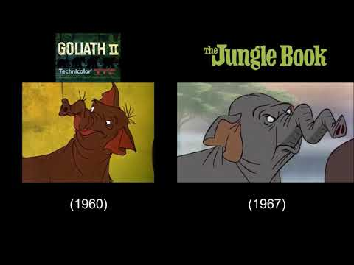
Before Computers
Hand-drawing
Large animation projects (movies) often reused animations
Saves cost on production
Some argue projects emulate similar “artistic” style

Slide 5
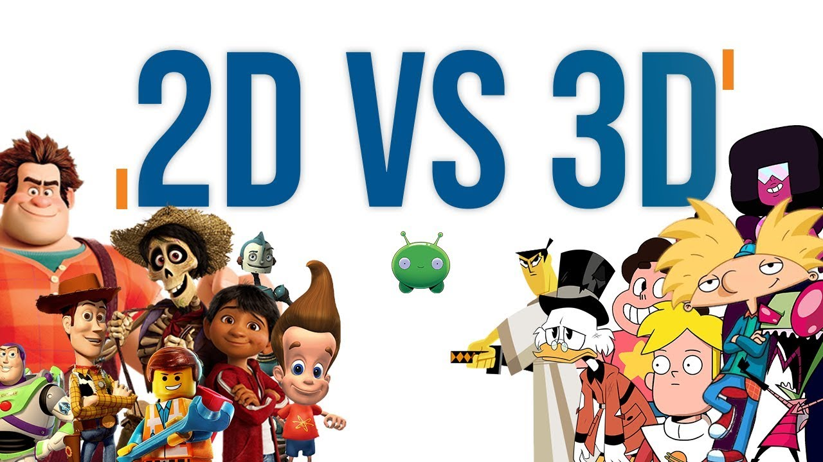
What is Computer Animation?
The process used for generating animated images
CGI
Computer Generated Images
Uses both static scenes and dynamic images
3D computer graphics typically used today, but 2D still finds areas of usage

Slide 6
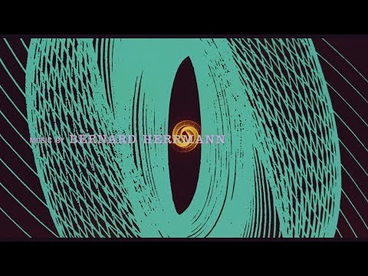
The First Computer Animation
Vertigo (1958)
Opening sequence created by John Whitney
Required a WWII anti-aircraft targeting computer to complete
“The M5 Gun Director”
850 lbs, consisting of 11,000 components and required 5 people to operate

Slide 7

The First Computer Animation
Vertigo (1958)
Device used to create considered “mechanical” computer
Earlier examples consisting of oscilloscope films existed, but said films are not considered as computer graphics by today’s standard
Whitney later went on to create Catalog (1961), which is considered the first computer animated short film

Slide 8
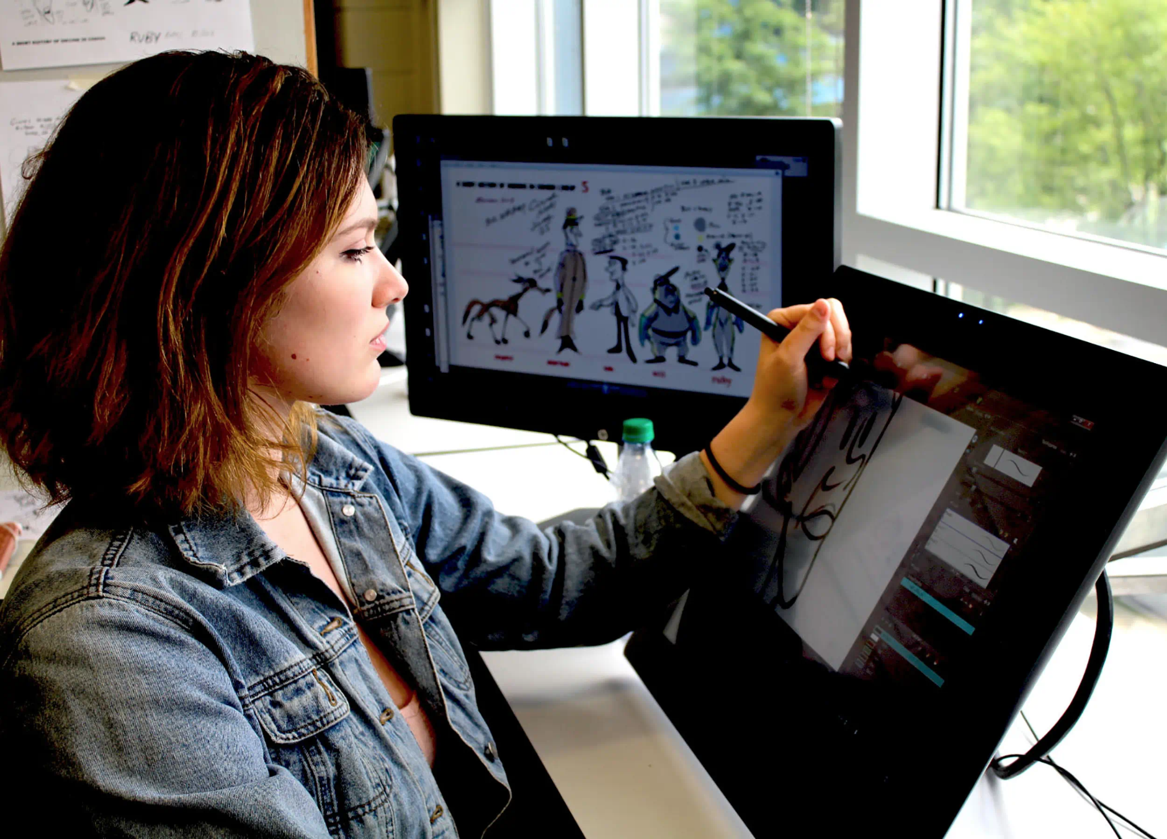
Advantages
Not having to manually draw and display each frame by hand allowed even the earliest works of computer animation to be significantly more efficient than its hand-drawn counterpart

Slide 9
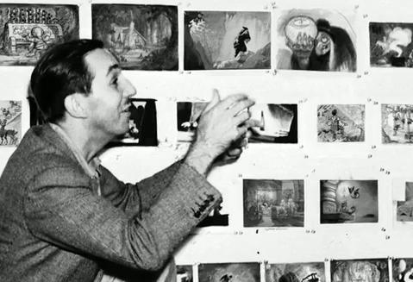
Advantages
Frame-by-frame animation requires 24 frames per every second of video
Computer animation saves whoever is responsible for the work significant time and manpower as a result
Various methods created to limit such tedious multitude of work

Slide 10
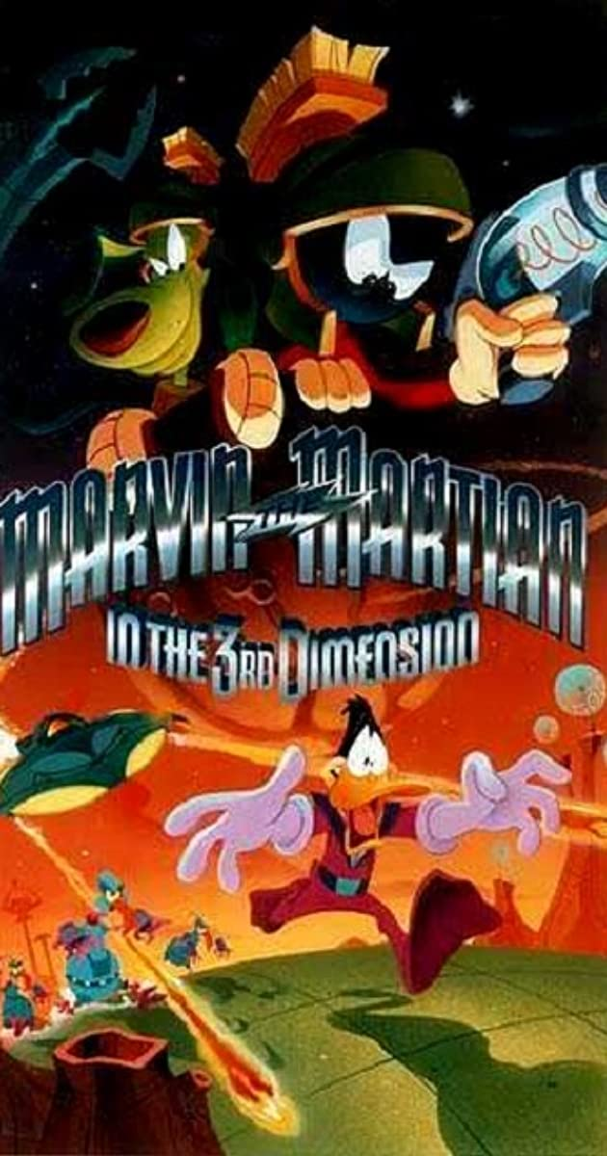
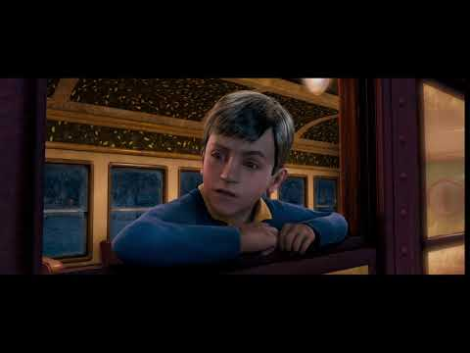
More Animation History
Marvin the Martian in the Third Dimension (1996)
First short polygonal film in stereoscopic 3D
The Polar Express (2o04)
The first stereoscopic 3D CGI full length film

Slide 11

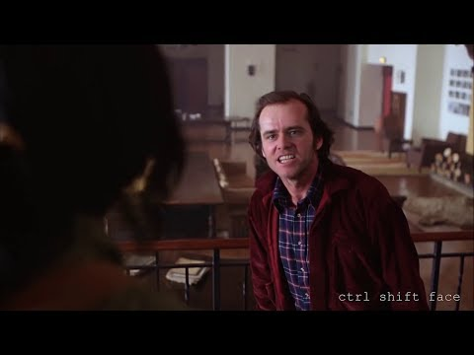
More Animation History
X-Men: The Last Stand (2006)
First usage of CGI De-aging within a film
The Shining (with Jim Carrey) (2019)
Advanced deepfake technology

Slide 12
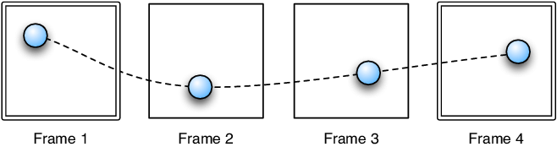
Computer Animation Techniques
Keyframing
Closest technique to hand-drawn, frame-by-frame animation
Key Frame: A frame where changes are defined within an animation
In frame-by-frame animation, every existing frame is defined as a key frame

Slide 13
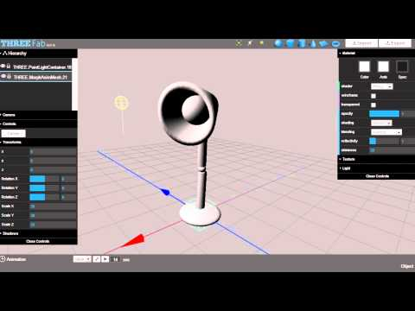
Computer Animation Techniques
Keyframing
In typical use, keyframing involves the artist drawing the major (or most significant) frames of animation, defining the object’s key position in the process
The computer then effectively “fills in” the missing frames to save significant time and create an efficient process

Slide 14
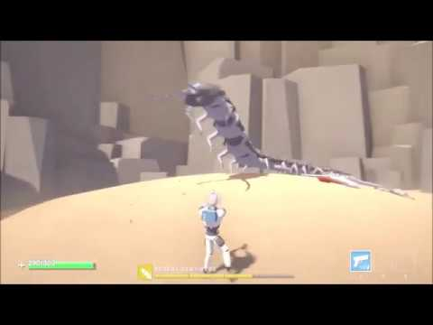
Computer Animation Techniques
Procedural Animation
Objects animated by a specific set of rules, as opposed to keyframing
Such rules are defined by the artist, and often based off of real life concepts such as mathematical equations

Slide 15
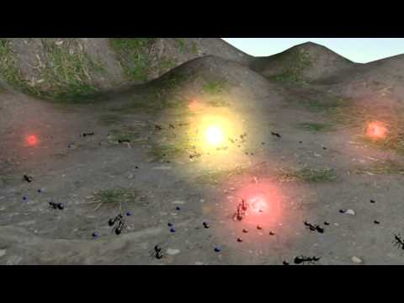
Computer Animation Techniques
Behavioral
The character or object itself essentially determines its own actions, based off of how it is created
Allows the artist to avoid specifying every detail of the object’s motion, saving more time for other tasks

Slide 16
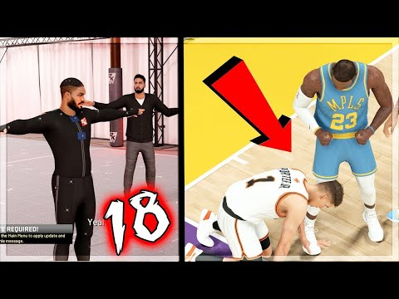
Computer Animation Techniques
Motion Capture
Records live-action footage by a human and uses footage to ‘recreate’ the animation
Ever growing in popularity from improving technological advancements
Ex: Modern NBA 2K video games

Slide 17
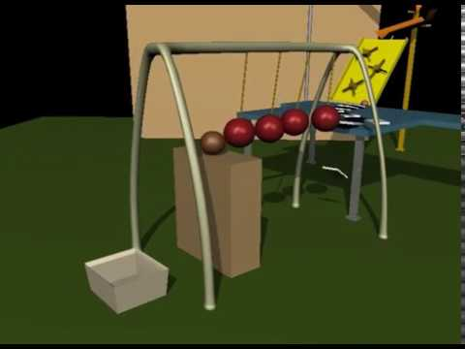
Computer Animation Techniques
Physics-based Dynamics
Computer-based simulations created to simulate motion and animation
Can be used with real-life simulations, but does not necessarily need to unlike motion capture
Laws of physics used heavily within simulations to generate accurate and realistic animation

Slide 18
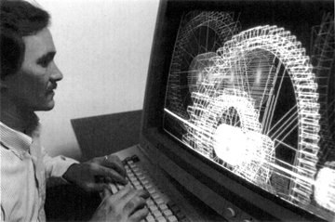
Conclusion
History
First public animations from the ‘50s, much more advancements within the industry since then
Hand-drawn animation: less of a go-to and more of an art style
Introduction to 3D animation

Slide 19
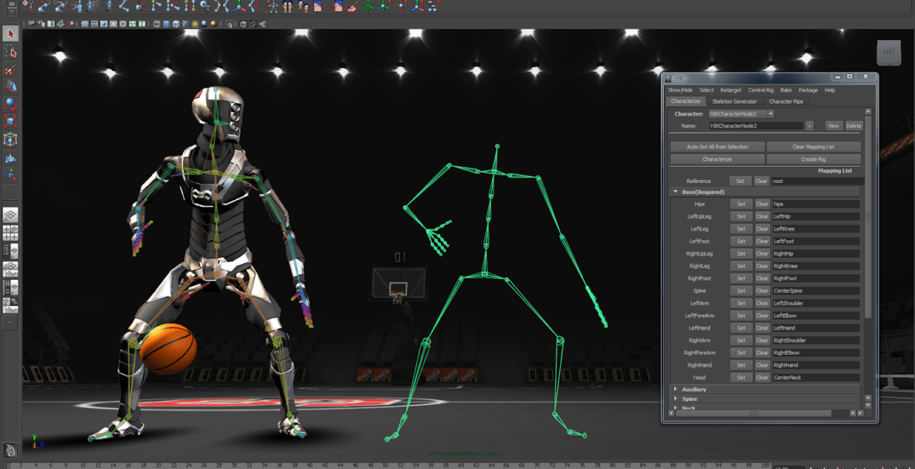
Conclusion
Types of Computer Animation
Keyframing
Procedural
Behavioral
Motion Capture
Dynamics

Slide 20
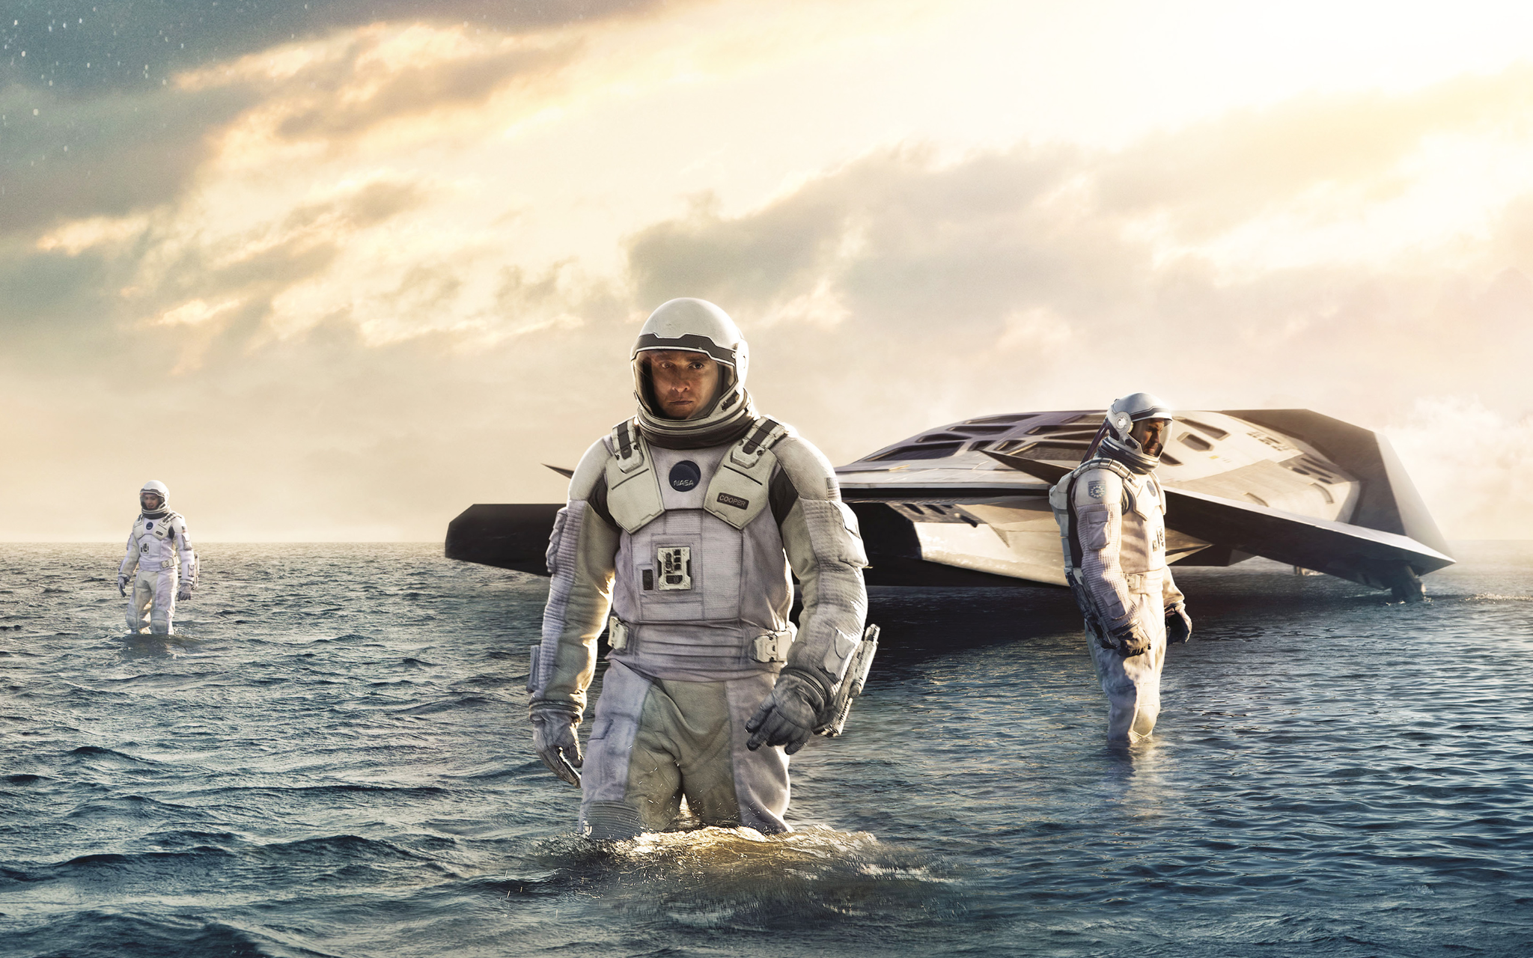
Conclusion
Importance
Allowed animation to become a less tedious and work-heavy process
Allowed the entire media industry to advance at a much faster pace
Easier it is to create animation, the more accessible for people to do it and push its technical boundaries
Led to breakthroughs within the graphics community

Slide 21
References
https://www.intofilm.org/films/filmlist/91
And corresponding nesting pages referenced
https://computeranimationhistory-cgi.jimdofree.com/
https://www.geeksforgeeks.org/computer-animation/
https://www.britannica.com/topic/computer-animation
https://www.tutorialspoint.com/computer_graphics/computer_animation.htm

Slide 22
References
Videos
https://youtu.be/LJ5whXhTiKc
https://youtu.be/GQwp6M2q1NE
https://youtu.be/Nie3DAilv8Y
https://youtu.be/sUH0v-WX9kg
https://youtu.be/d730cBYrL-0
https://youtu.be/IIff01h4Jso
https://youtu.be/u0U0b-8s5rk
https://youtu.be/miB4qah7n_A
https://youtu.be/FHrn6eUz11I
https://youtu.be/Y-vDjgF3rsQ
https://youtu.be/5cyrR7H7PLU

